Slide 1
Near By Restaurant
Group Members
Navneet Kaur – s333546
Hamza Farooq – s349021
Khang Nguyen – s322849
Assignment 2

Slide 2
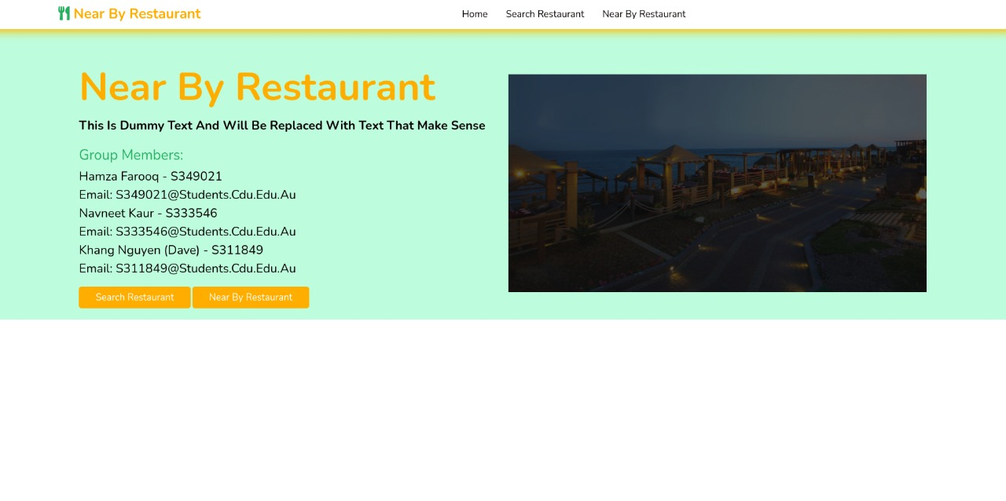
Introduction
Near By Restaurant is an web app where user can explore and search restaurants , user can also see restaurant details , reviews , menu and also can leave comment over there.

Slide 3
Features
Homepage
Navigation Bar
Search Restaurant
Reviews
Restaurant Details
Near By Restaurant

Slide 4
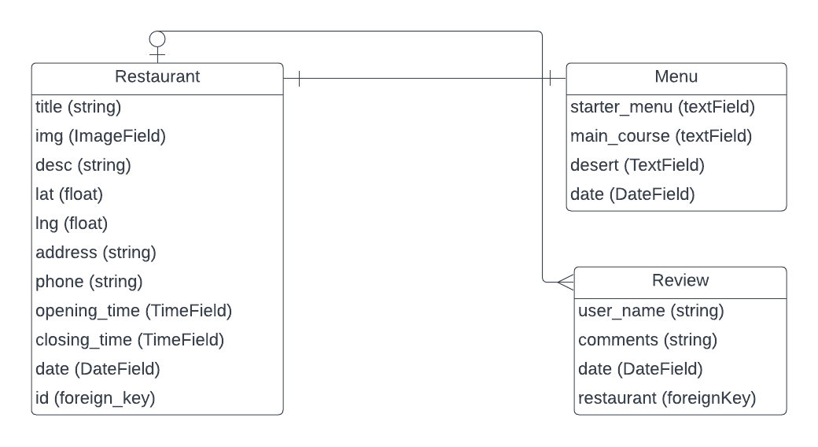
ERD Diagram

Slide 5
Classes ( Data Models )
Name | Type | Constraints | Description | Example
id | Numeric | Primary Key | Unique key to identify row | Id: 234
Title | String | Not Null & Max_length = 150 | Name of the restaurant | KFC
Img |  | Not Null | Image of the restaurant | -
Desc | String | Not Null | Description about Restaurant | Its too good
Lat | Float | Not Null | Latitude of restaurant for pin location | 34.343
Lng | Float | Not Null | Longitude of restaurant for pin location | 24.434
address | String | Not Null | Address of the restaurant | Street 405 new York usa
phone | String | Max_length = 16 | Phone Number of Restaurant | +1 9374 4387 7
Opening_time | TimeField | Not Null | Opening time of restaurant | 9:00 am
closing_time | TimeField | Not Null | Closing Time of Restaurant | 10:00 pm
date | DateField | Not Null | Date at which restaurant has been added | 01/02/2022 – 10:34:54
id | Numeric | Foreign Key | Foreign key of Menu | Menu 1
Restaurant

Slide 6
Classes (Data Models)
Review
Name | Type | Constraints | Description | Example
id | Numeric | Primary Key | Unique key to identify row | Id: 234
Starter_menu | String | Not Null | Description about starter menu | Russain salad, yogurt
Main_course | String | Not Null | Description about main course menu | Chicken burgur, Roll
Desert | String | Not Null | Description about desert menu | Donuts , sweet
date | DateField | Not Null | Date at which menu has been added | 01/02/2022 – 10:34:54

Slide 7
Classes ( Data Models )
Menu
Name | Type | Constraints | Description | Example
id | Numeric | Primary Key | Unique key to identify row | Id: 234
User_name | String | Not Null | Name of the person that wants to comment | navneet
Comments | String | Not Null | Review about restaurant | Nice restaurant
date | DateField | Not Null | Date at which menu has been added | 01/02/2022 – 10:34:54
restaurant | DateField | Not Null | Date at which menu has been added | kfc

Slide 8
Screenshots

Slide 9
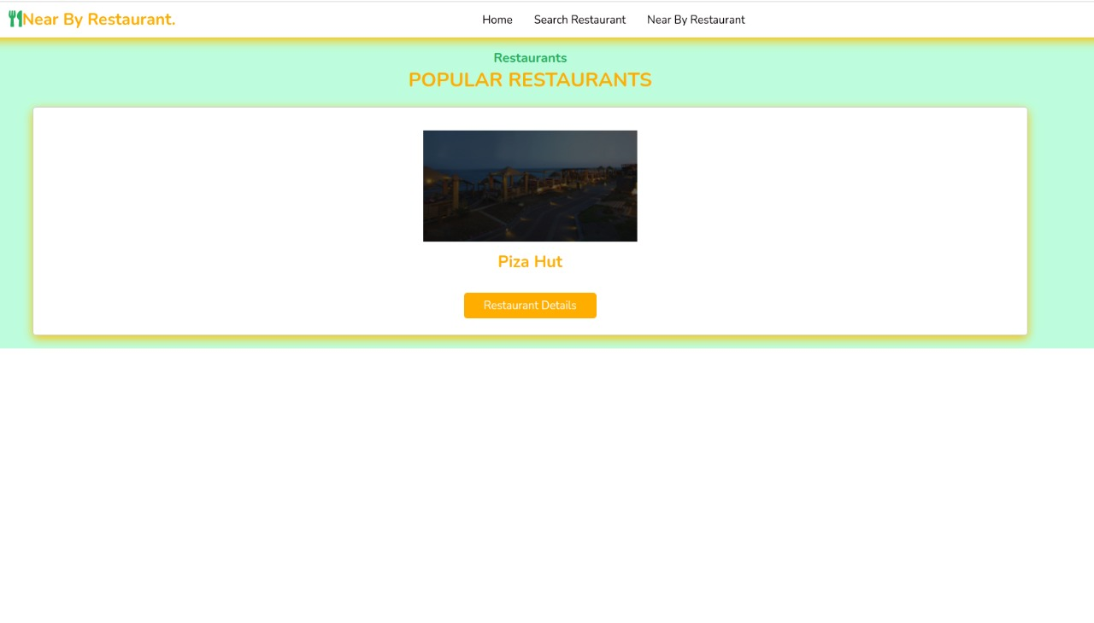
Screenshots

Slide 10
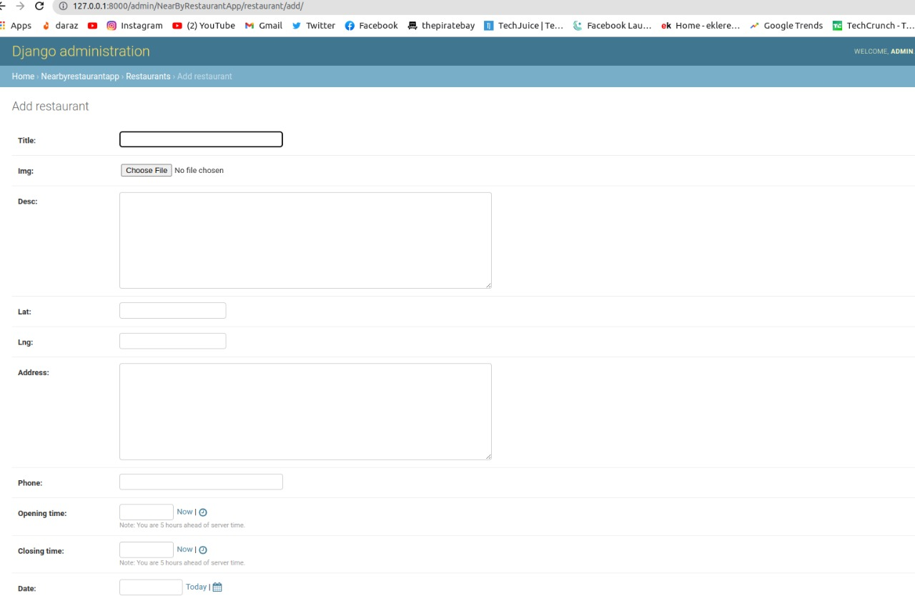
Screenshots

Slide 11
Thankyou!

